Slide 1

NAME. : M.Rakesh kumar
COLLEGE. : Agurchand Manmull Jain College
REGISTER NO. : 312206457
DEPARTMENT : B.com (General)

Slide 2


Slide 3


Slide 4


Slide 5


Slide 6


Slide 7
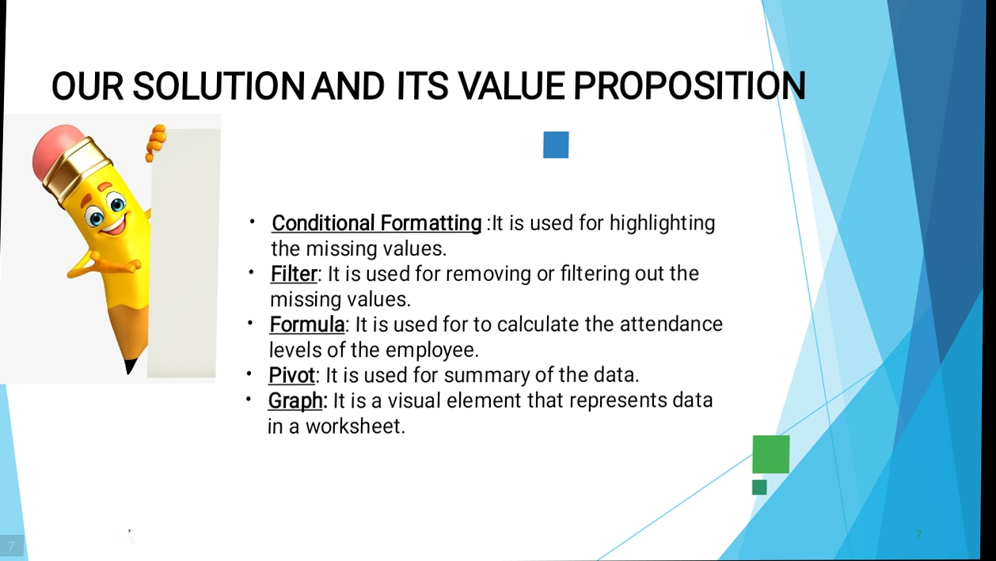

Slide 8


Slide 9


Slide 10
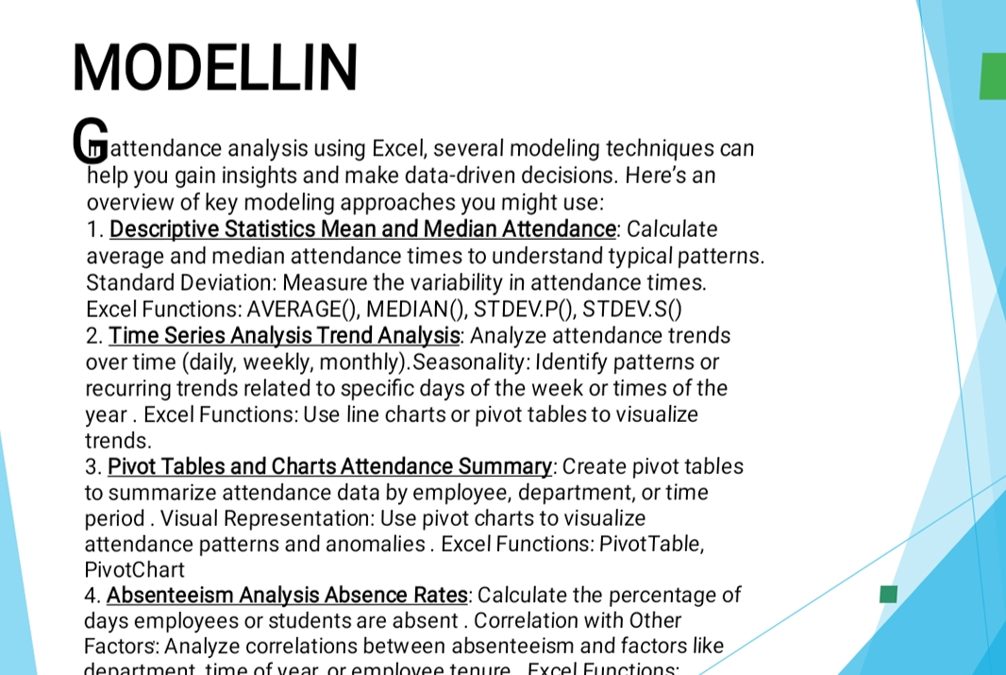

Slide 11
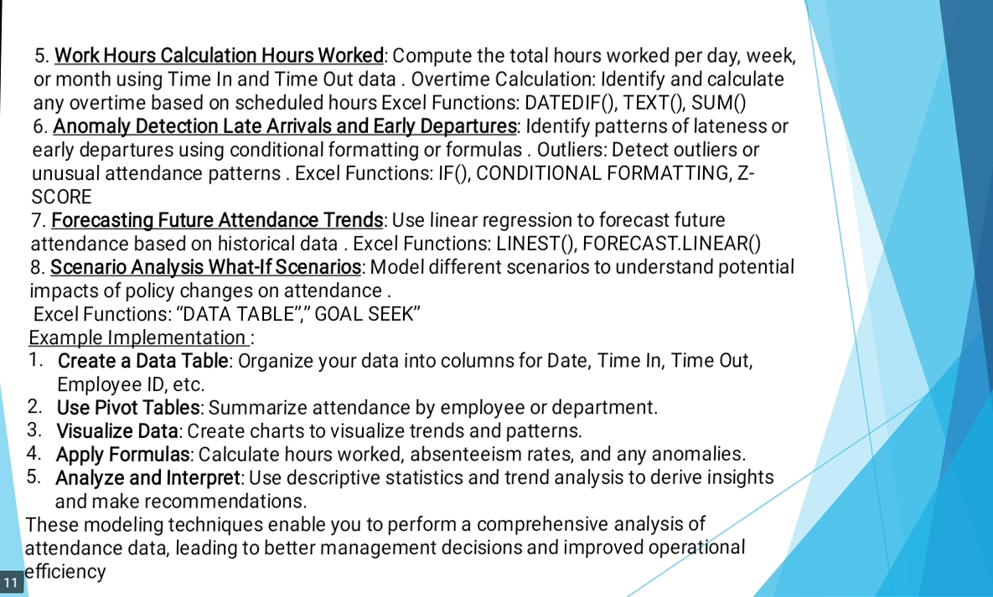

Slide 12
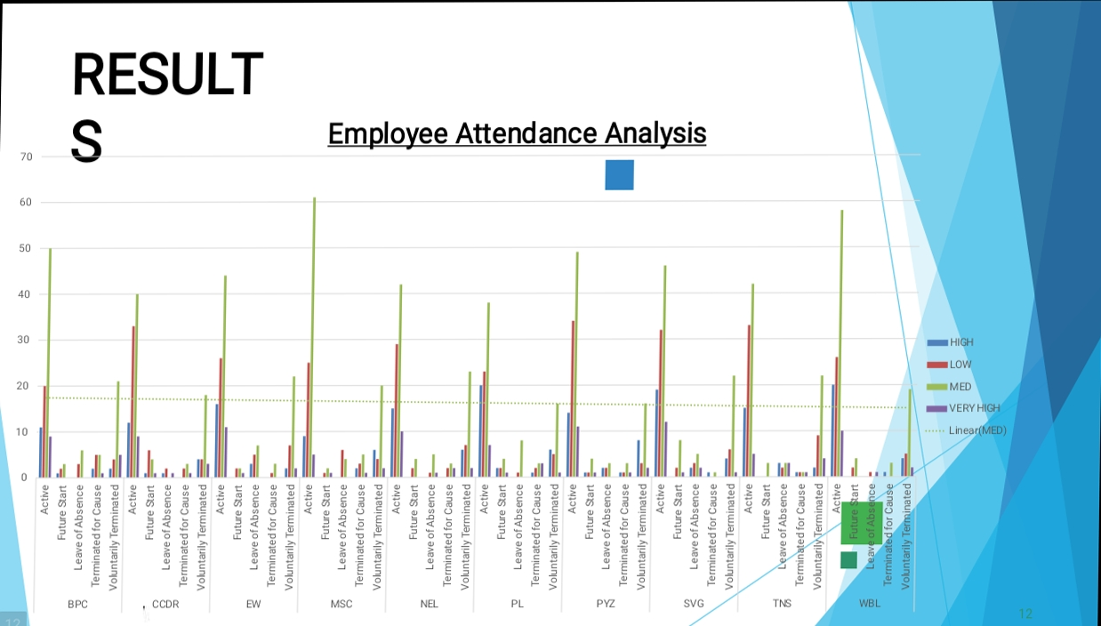

Slide 13


